Slide 1


A short intro to
dwong
Apr 29, 2025
19 pages, est. 17 mins

Slide 2
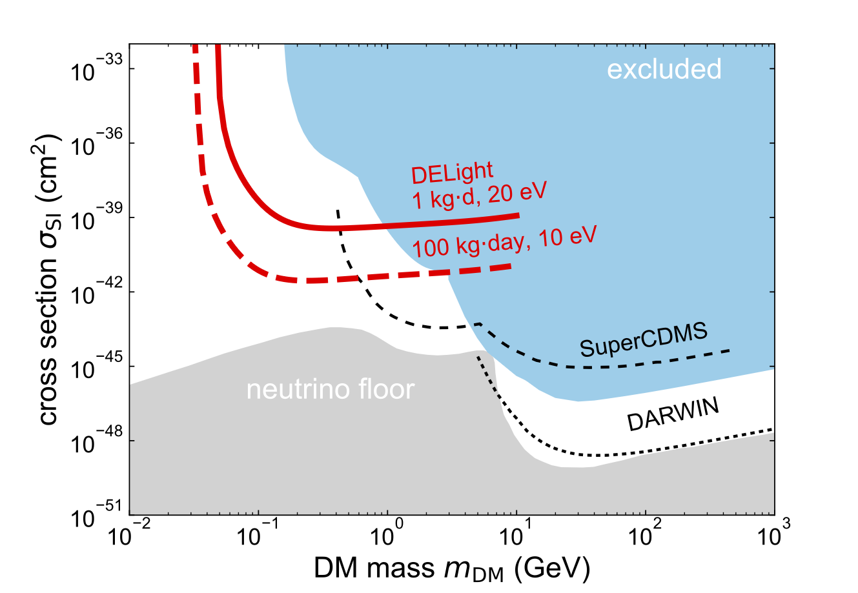
I. What is DELight?
Noble liquid dual-phase
phase TPCs constrain phase
space for large WIMP
Phase space for Light Dark Matter (LDM) is
mostly unexplored
DELight is an upcoming direct detection dark matter experiment using a novel approach to probe the thus far uncharted low mass dark matter parameter space. We will search for interactions of dark matter in superfluid helium.

Slide 3
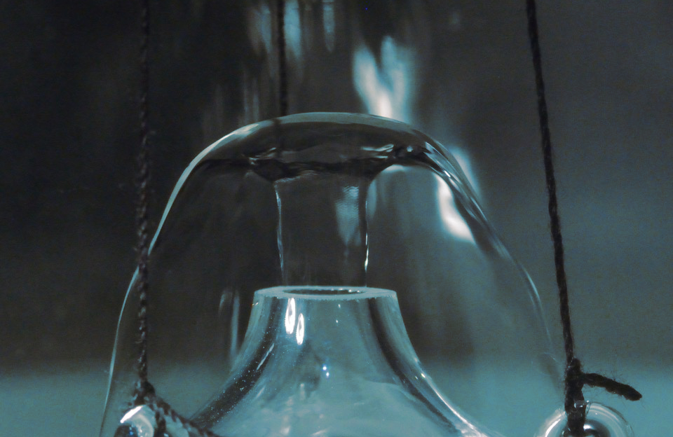
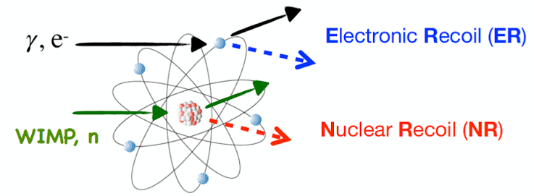
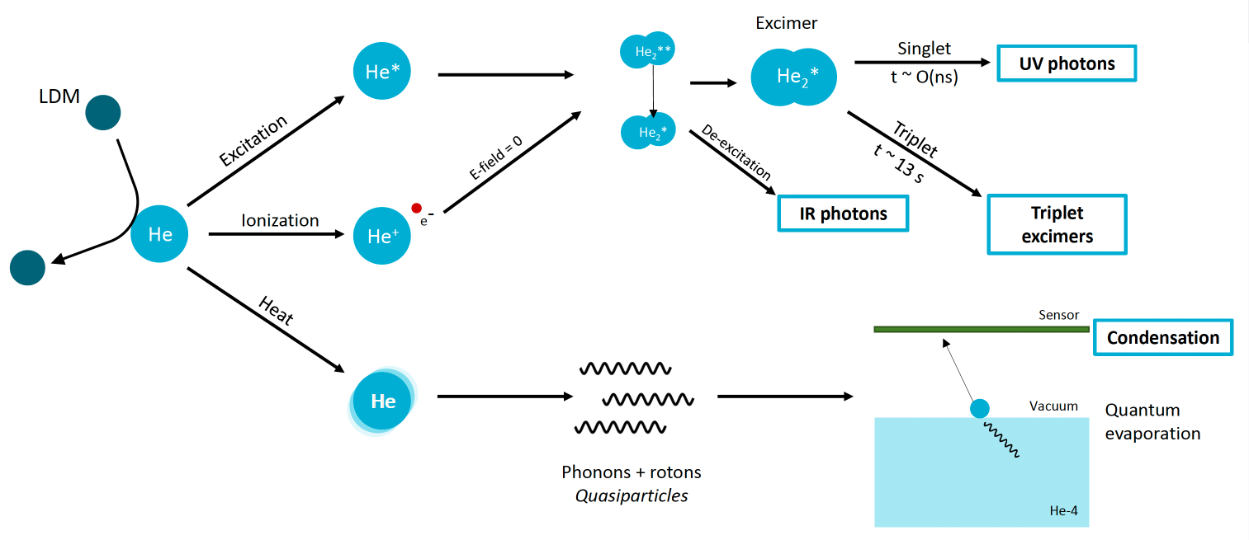
II. Novel_approach_0: What’s unique?
– Events and physics signature
Type of Recoil | Example Models | Scattering Type | Target | Energy Transfer
Electron Recoil (ER) | Dark photons, ALPs, millicharged particles | Elastic and inelastic | Electron | Excitation / ionization
Nuclear Recoil (NR) | Light WIMPs, Asymmetric DM | Elastic (mostly) | Nucleus | Kinetic energy to nucleus
🎯Targets:
Photon
Quasiparticles
LDM refers to the DM with energy < 1GeV

Slide 4
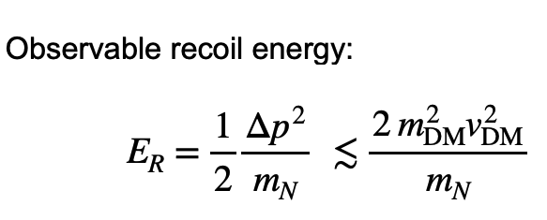
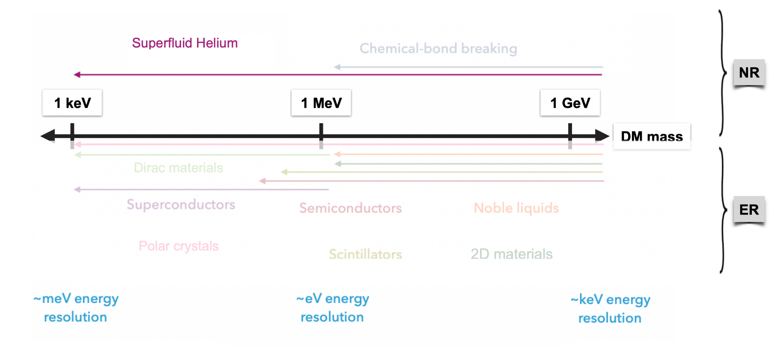
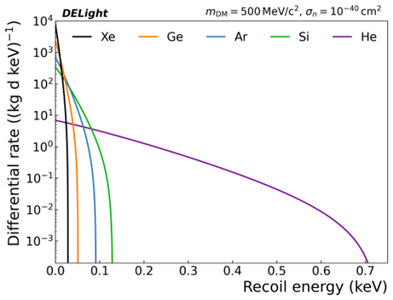
II. Novel_approach_1: What’s unique?
– Superfluid Helium as detection medium
Light nuclei maximize recoil energy for LDM
Not expensive
Ultra-pure (Impurities freezing out)
Multiple signals (phonon & rotons, photons,excimers)
NR / ER discrimination
Fiducialization possible
Scalability
Overall concept demonstrated
SuperCDMS: Cryogenic germanium (Ge) and silicon (Si) crystals
XENONnTLUX-ZeplinDARWIN: Xenon
DarkSide, DEAP-3600: Argon
Helium is very light compared to typical direct detection target elements like Xe, Ar, Ge and Si. Consequently, the energy transfer from the LDM particle to a target nucleus in a scattering event is more efficient and the resulting signals reach higher amplitudes naturally providing sensitivity to lower DM masses.

Slide 5
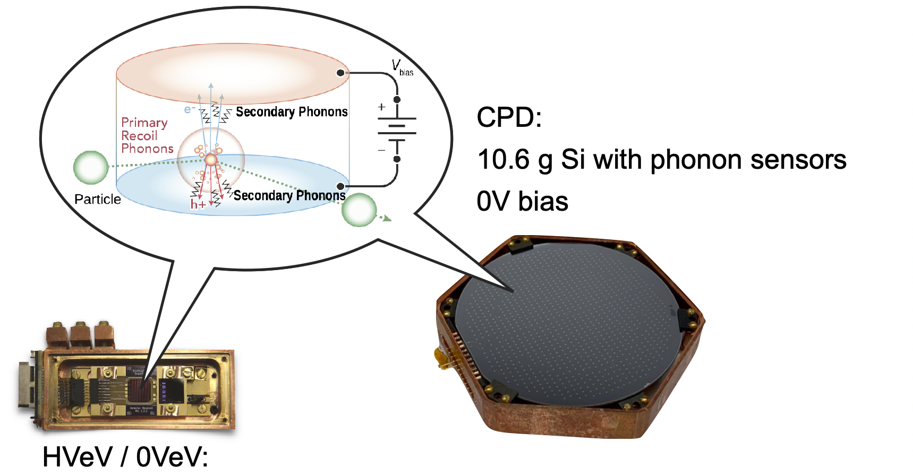
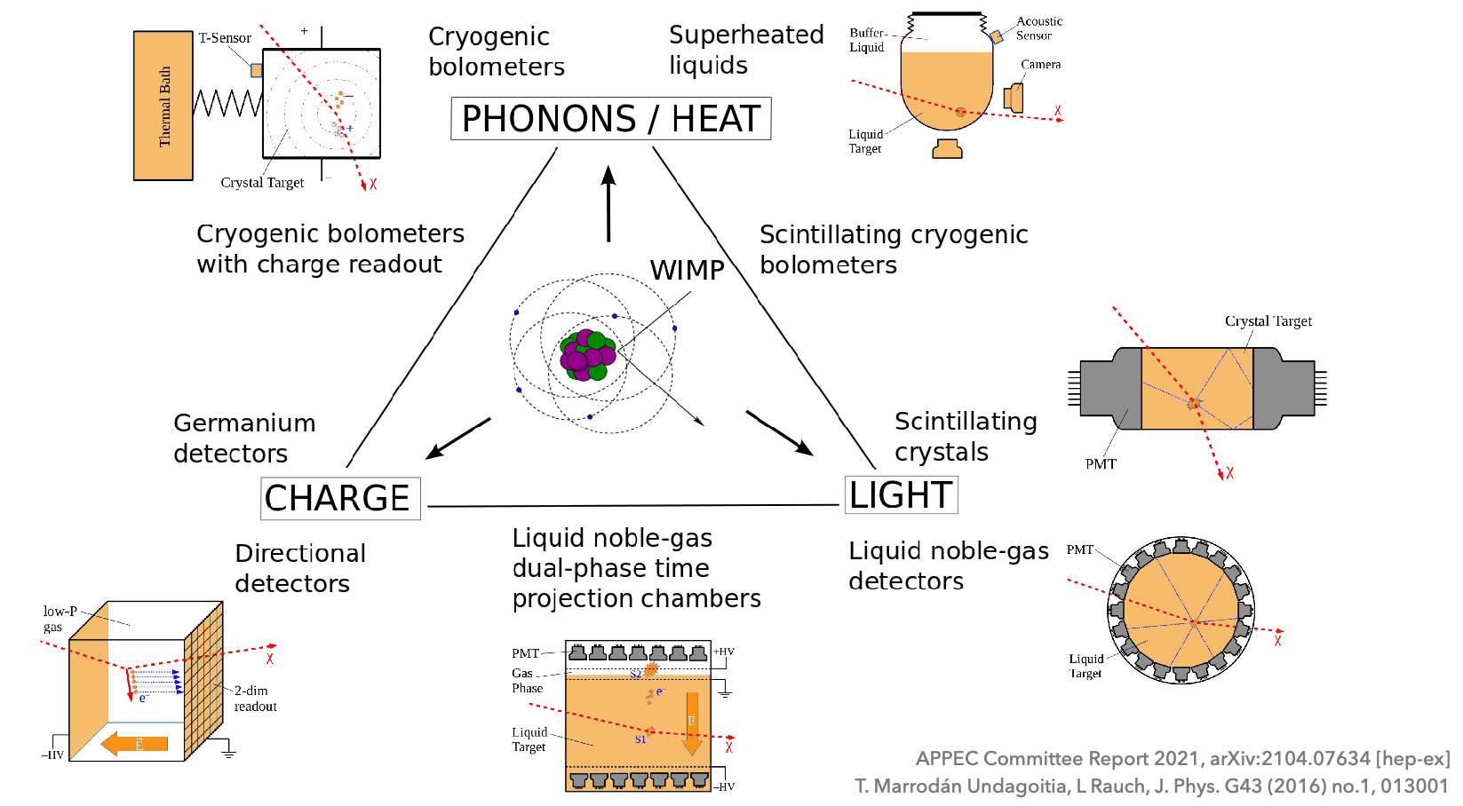
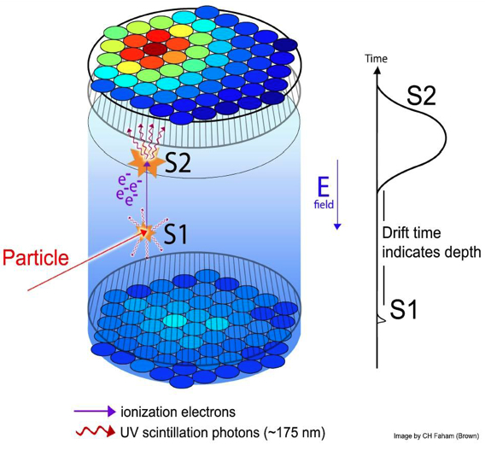
II. Novel_approach_2: What’s unique?
– Overview of DM detector technology
Bolometers: SuperCDMS, CRESST and EDELWEISS
Liquid noble gas
Scintillating Crystals, Ionisation Detectors, Bubble Chambers
Scintillating crystals (like NaI(Tl), CaWO₄) give off light when a particle hits them.
Ionization detectors measure charge directly from interactions.
Bubble chambers show a visible bubble trail when particles interact in a superheated liquid.
Bolometer at SuperCDMS
TPC at LZ

Slide 6
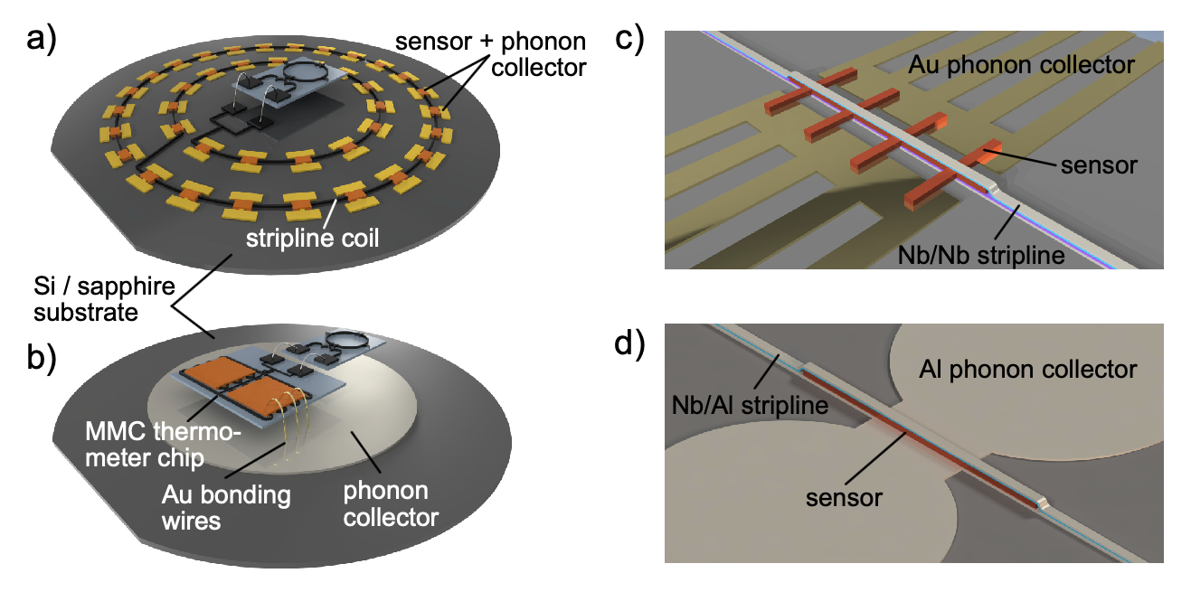
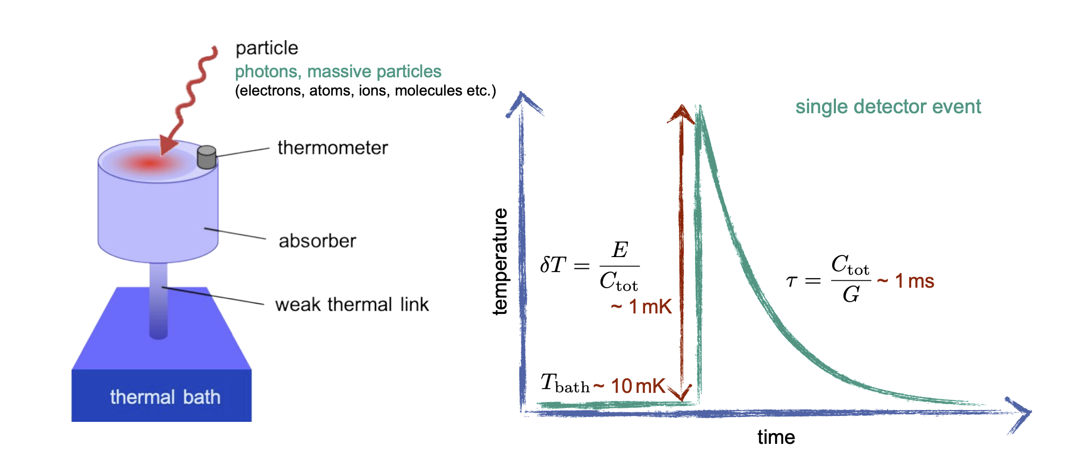
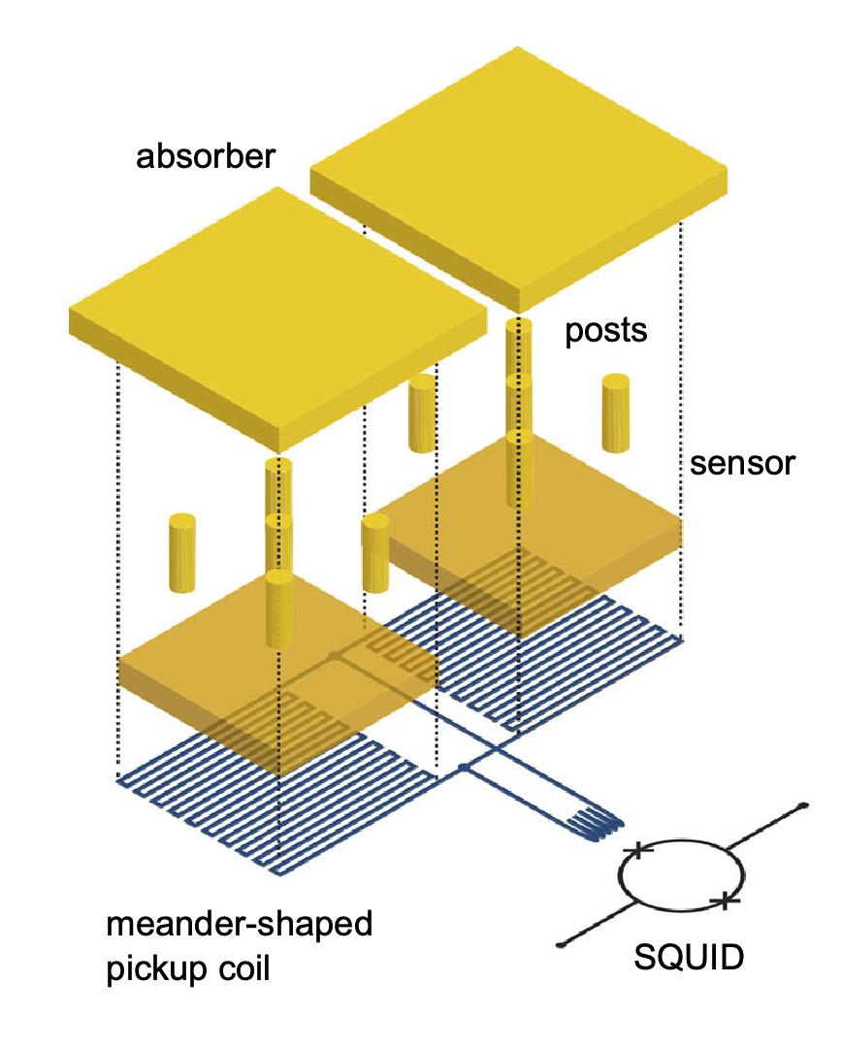
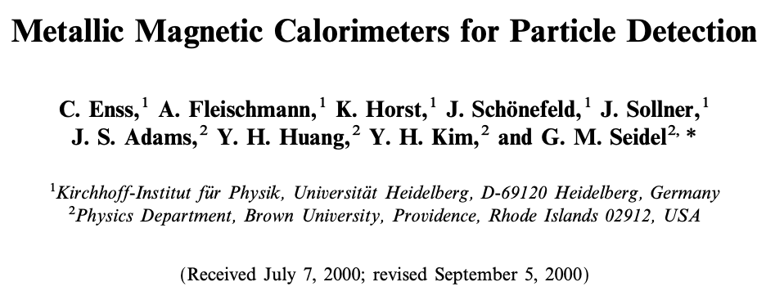
II. Novel_approach_3: What’s unique?
– MMC in a nutshell
We have reached ΔEFWHM = 1.25 eV at 5.9 keV (Fe-55 lines), which is the current world record.
low noise ( ε = 50 .. 300 ħ )
large bandwidth / slew rate (MHz )
low power dissipation on detector SQUID chip (nW )
linear signal amplification
Physics and Applications of Metallic Magnetic Calorimeters
S. Kempf, A. Fleischmann, L. Gastaldo, C. Enss
DOI: 10.1007/s10909-018-1891-6

Slide 7
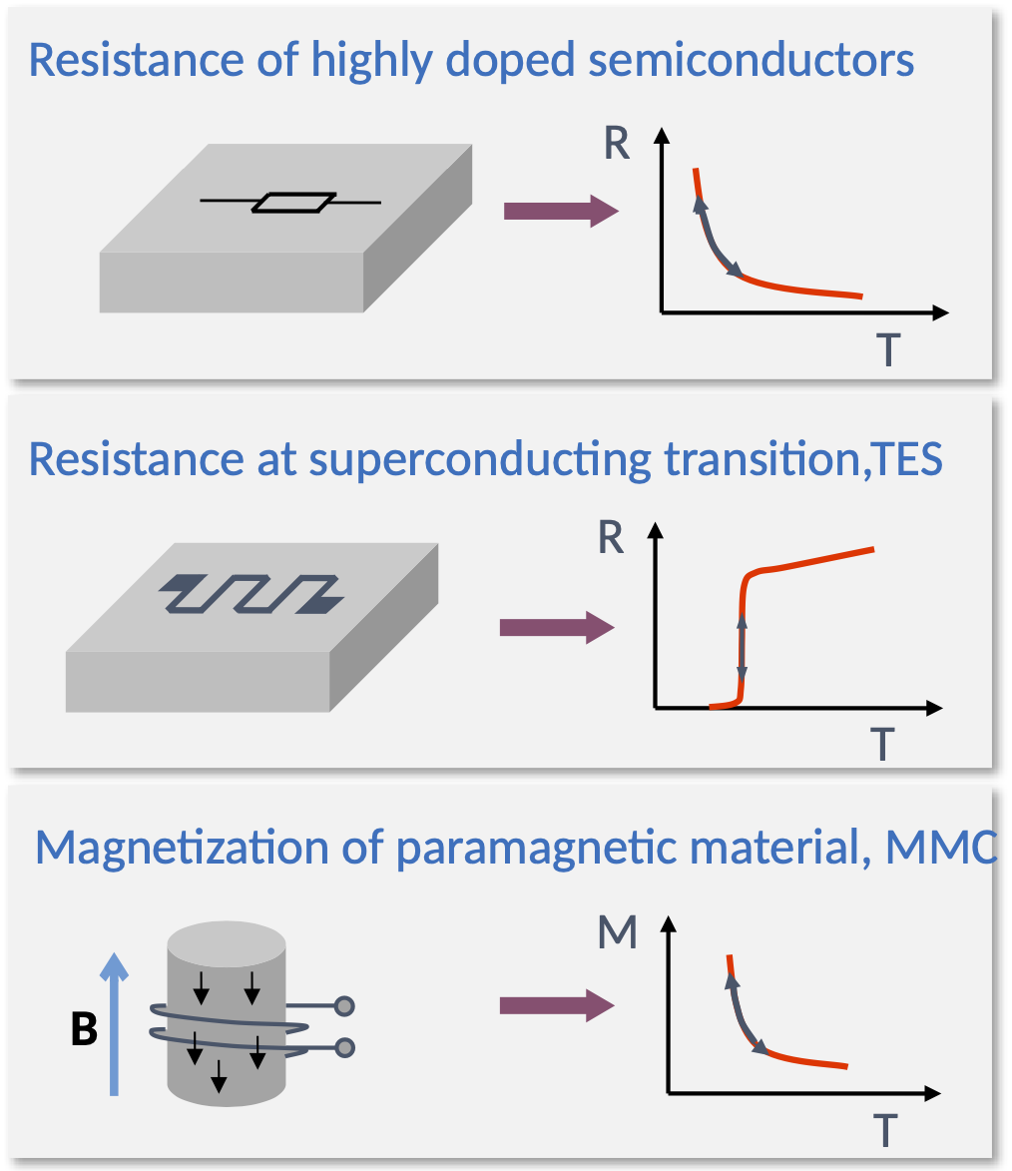
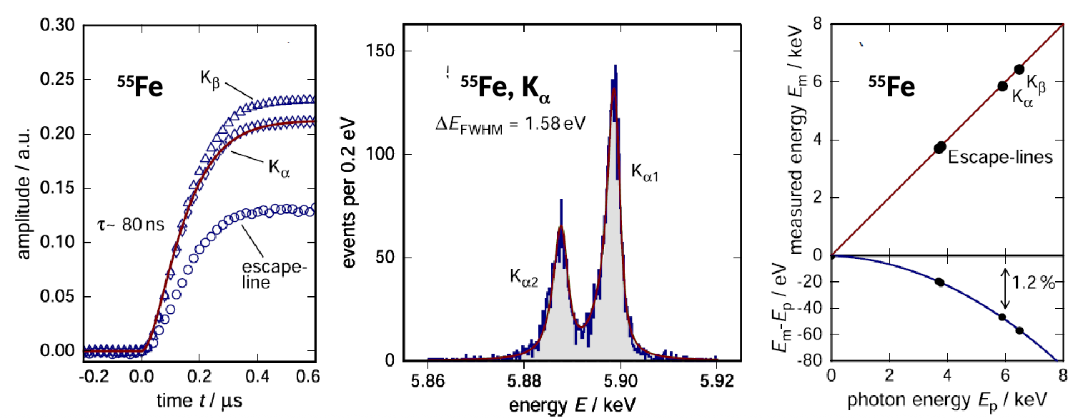
II. Novel_approach_3: What’s unique?
– MMC, cross comparison
Fast rise time
Reduction un-resolved pile-up
Extremely good energy resolution
Identification of small structures
Excellent linearity
Precise definition of the energy scale
Calorimeter | Sensing Method | Speed | Sensitivity | Typical Use
NTD | Resistance change in doped semiconductor | Slow | Moderate | Large-mass detectors (e.g., dark matter, neutrinos)
TES | Resistance change at superconducting transition | Fast | Very high | Photon, phonon, particle detection
MMC | Magnetization change in magnetic field | Fast | Very high | Precision particle detection, X-rays

Slide 8

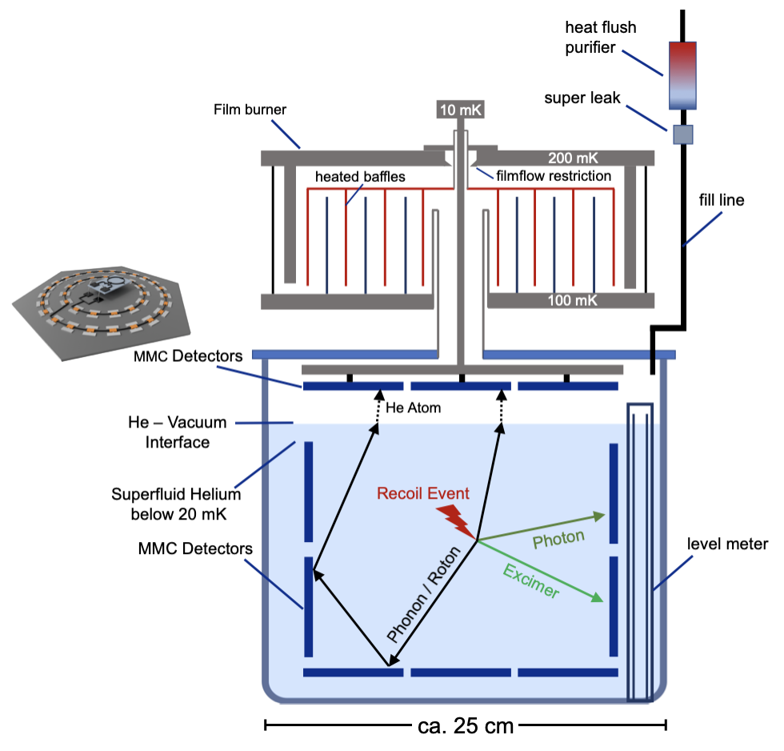
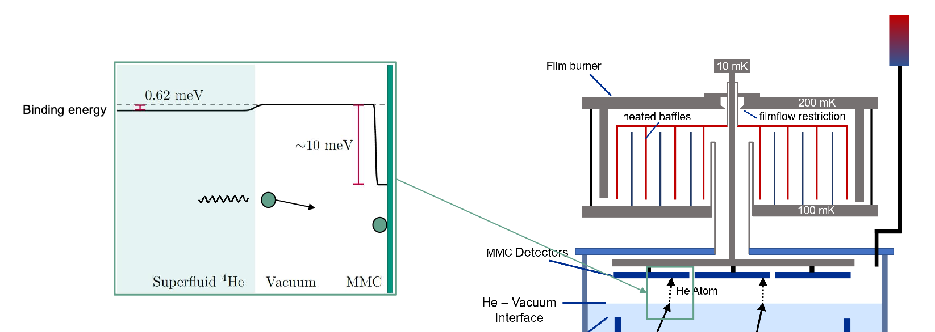
III. Dive into the cell_0
– Concepts of the test cell
Sponsored by
To prevent superfluid helium from creeping up walls and reducing detector sensitivity, DELight uses heated baffles ("film burners") to remove the helium film.
The MMC layout uses a hexagonal pattern on the top and bottom for maximum coverage, with rectangular patterns on the sides. The top lid houses a dense vacuum channel for phonon detection(quantum evaporation), while the bottom channels are more sparsely arranged.

Slide 9

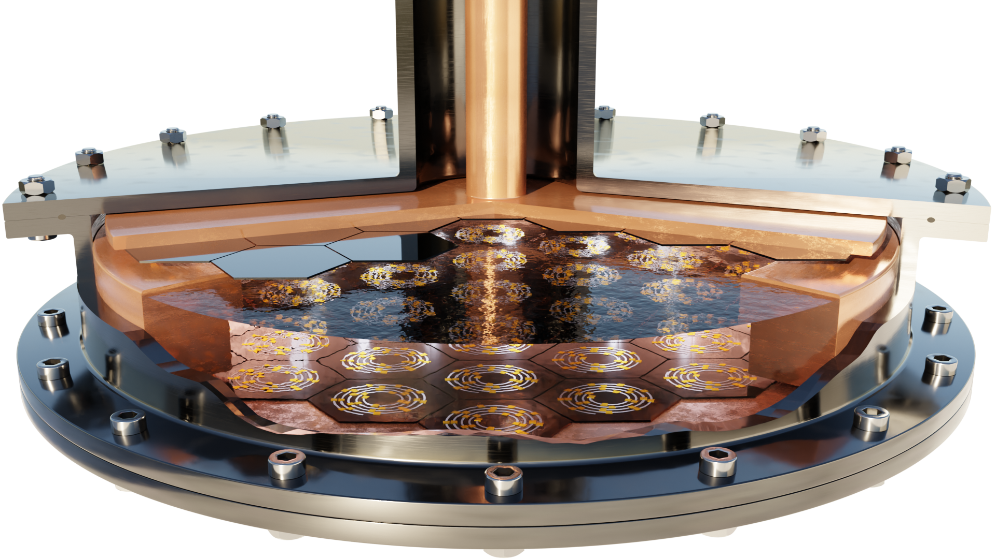
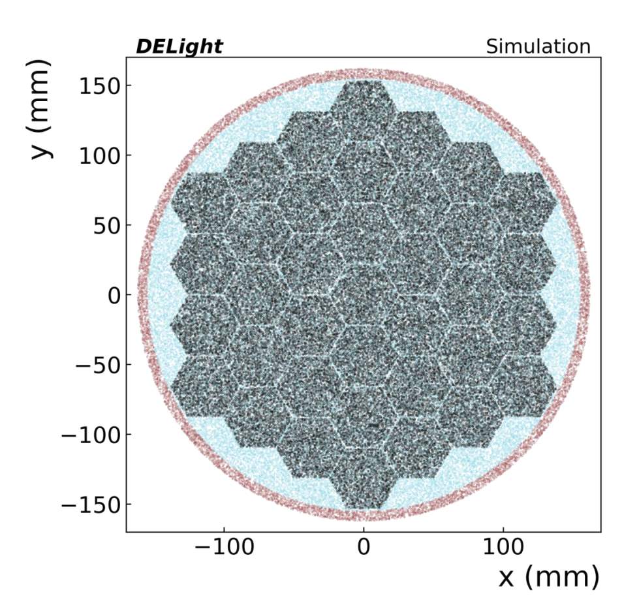
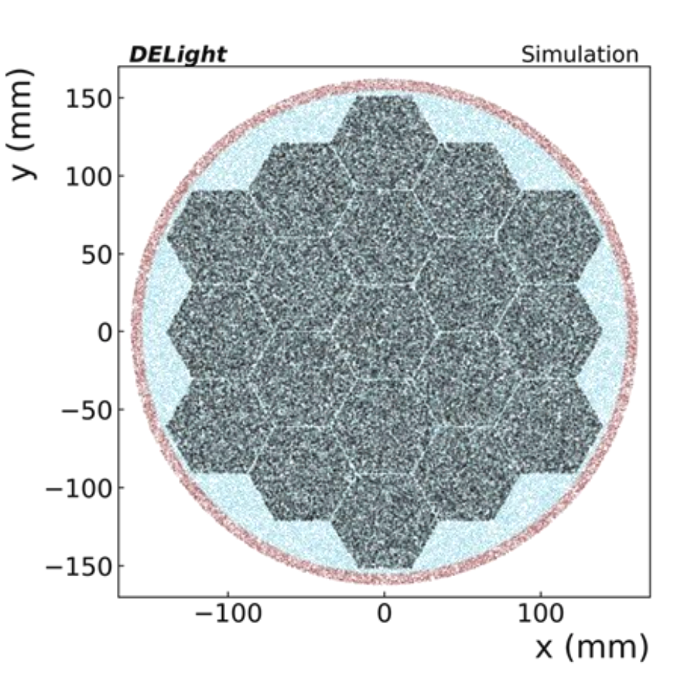
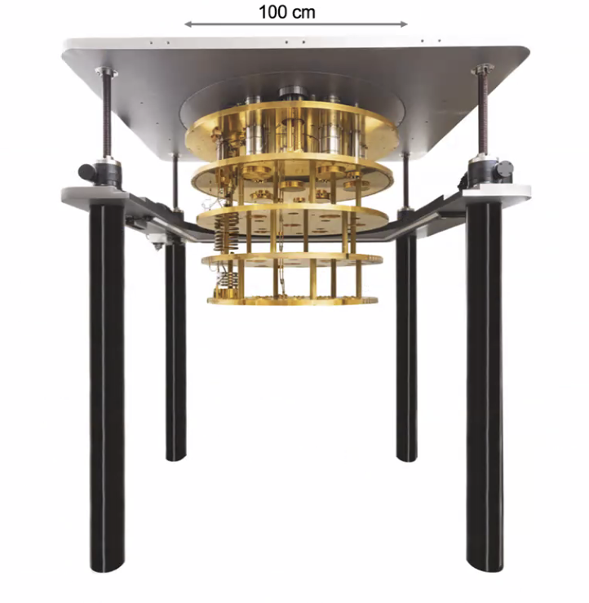
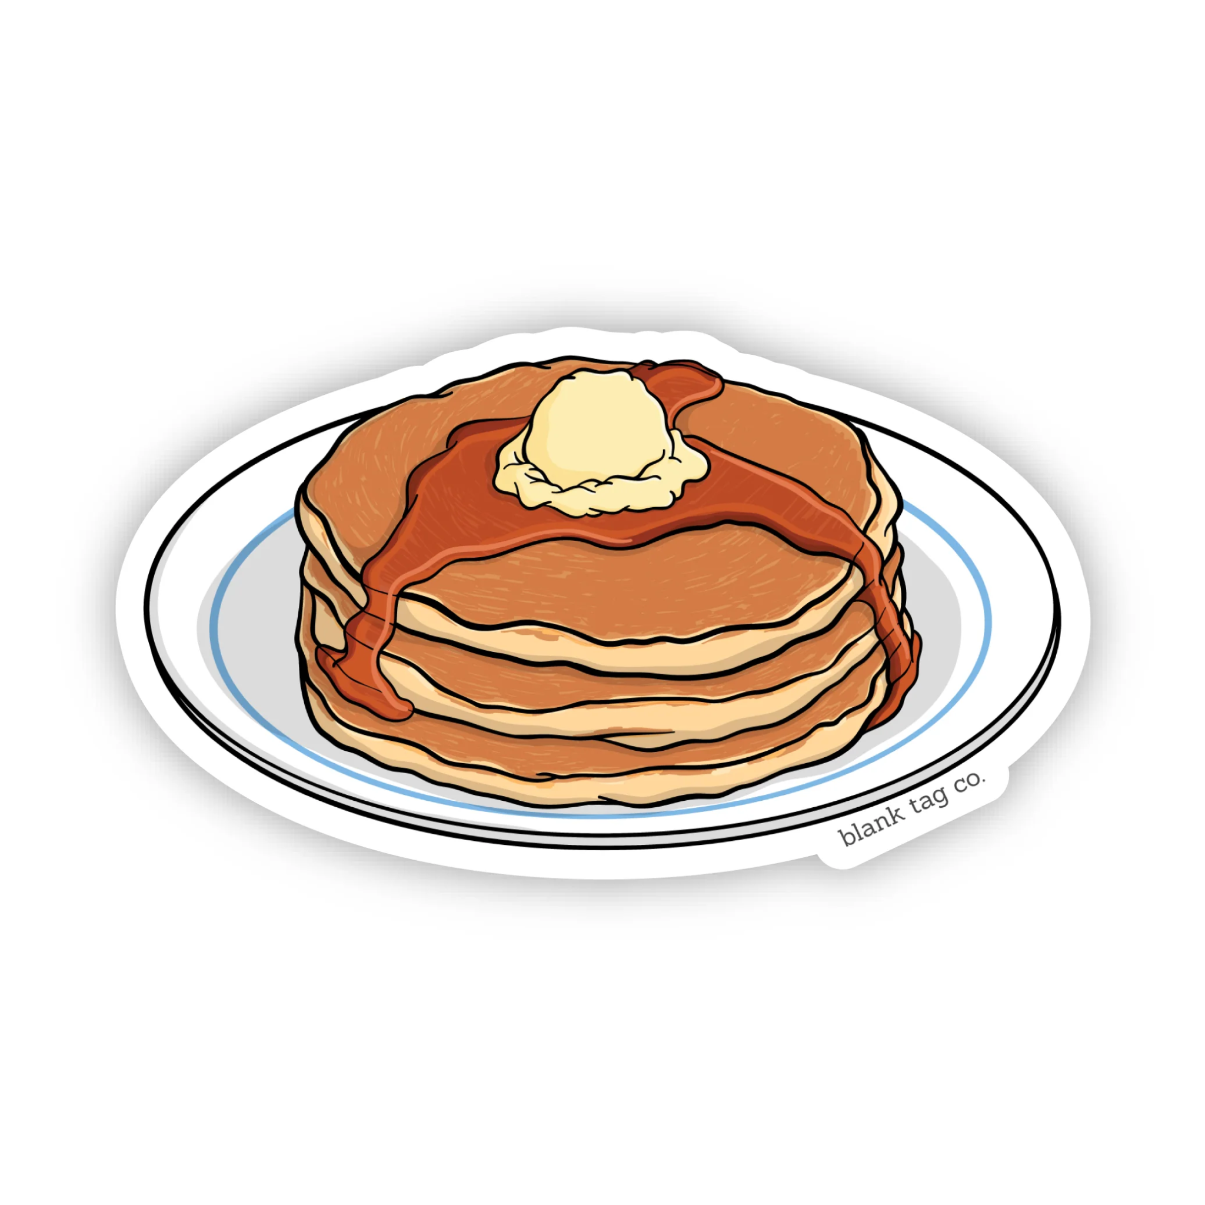
III. Dive into the cell_1
– Design of the test cell
Sponsored by
Vacuum channels(top)
Submerged channels(bottoms)
Phase I: 10 L pancake shaped cell in shallow lab O(kg*d) exposure 20-30 eV threshold, with total 56 detector channels(19 submerged and 37 vacuum). Going to grow bigger for Phase II.
MMCs in vacuum need to be 4He film-free to detect phonon→ film burner (already tested by HERON)

Slide 10
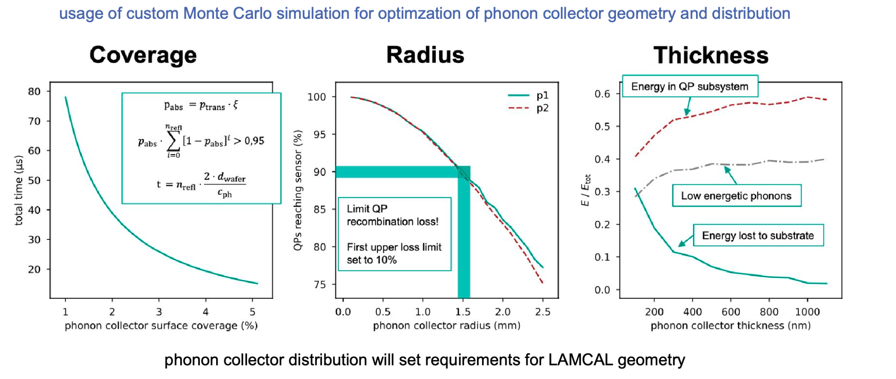
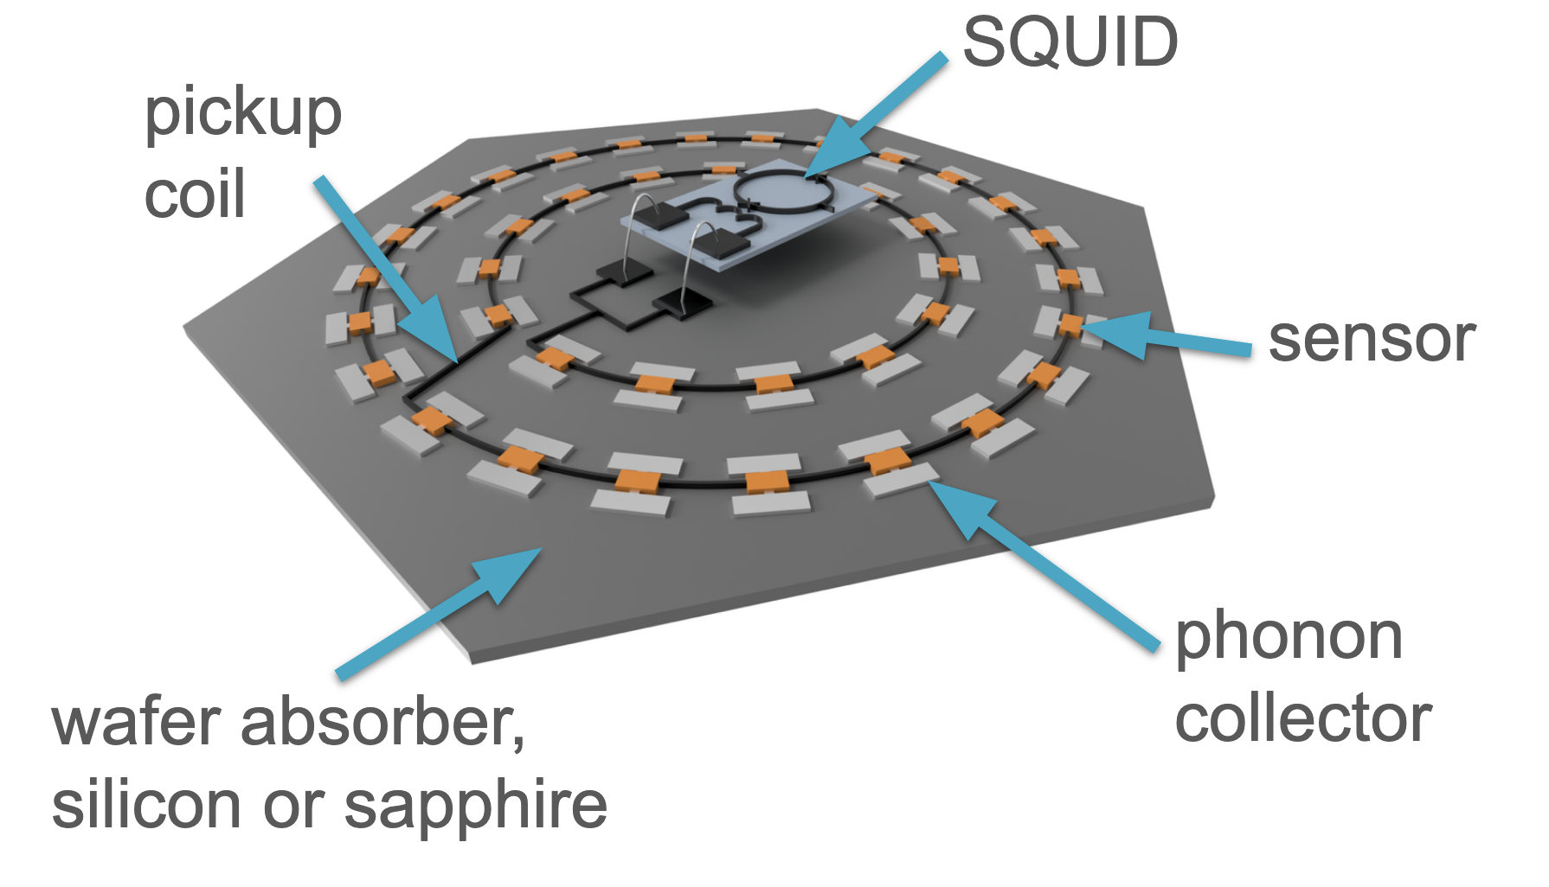
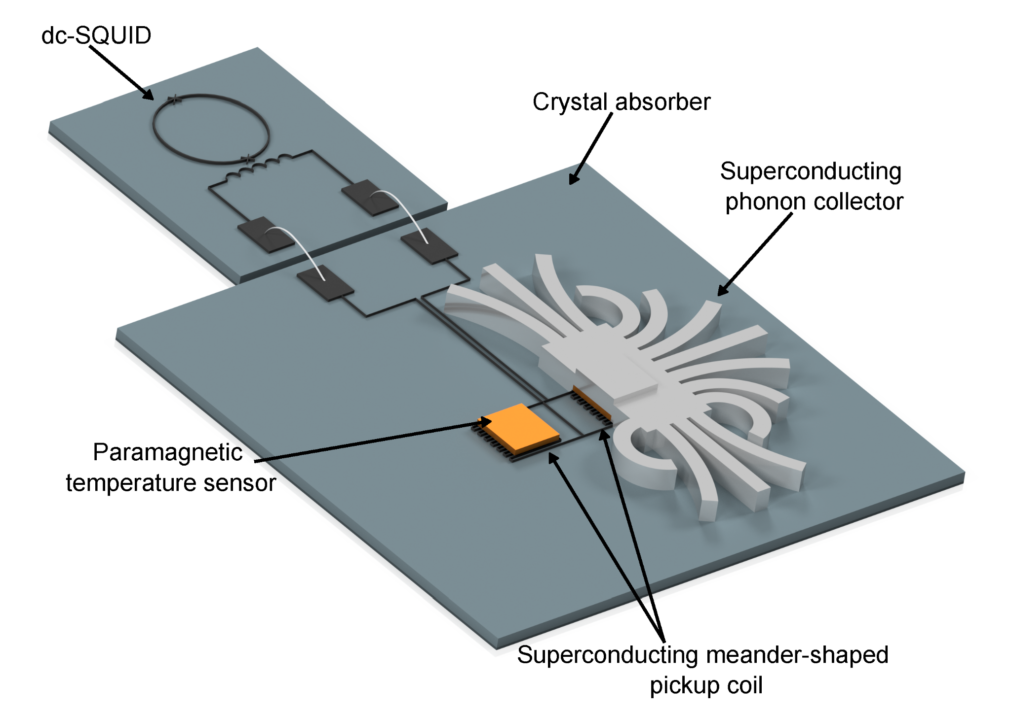
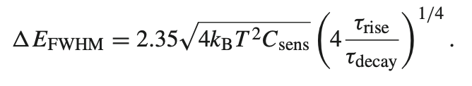
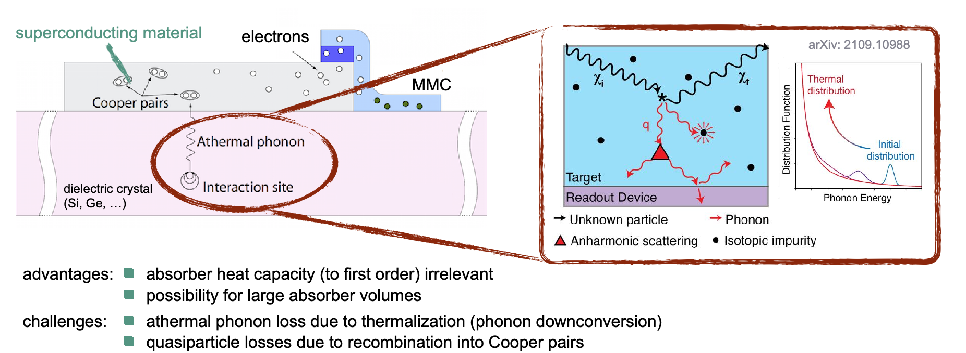
III. Dive into the cell_2
– LAMCAL_0: MMC based Superconducting phonon collector
Sponsored by
While effective at preventing phonon back-emission, phonon collectors add significant heat capacity due to conduction electrons, degrading energy resolution—especially as surface coverage increases.
DELight wafer calorimeters will use superconducting aluminum phonon collectors instead of normal-conducting Au structures, under Tc = 1.2 K, the heat capacity of the phonon collectors will be exponentially suppressed and can in fact be neglected

Slide 11
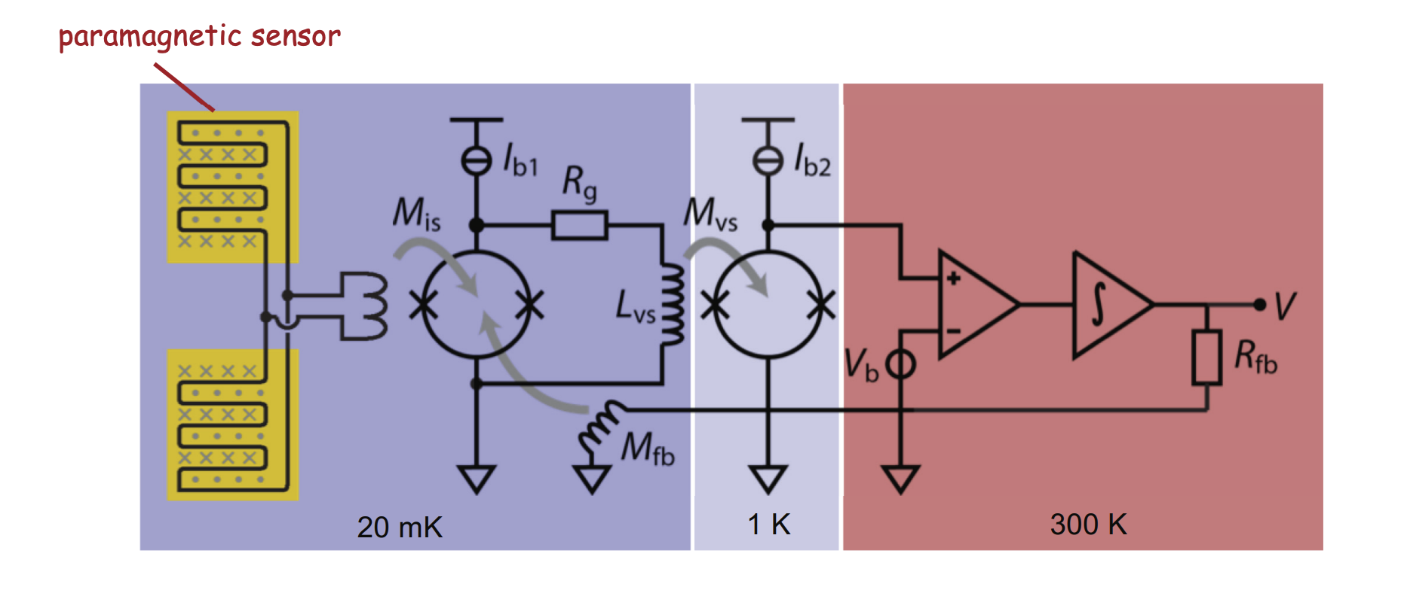
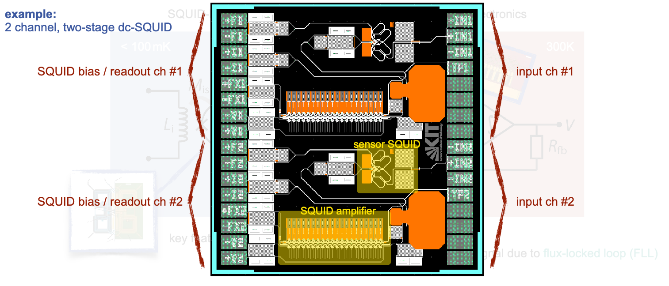
III. Dive into the cell_3
– LAMCAL_1: 2-stage dc-SQUID readout, multiplexing
Sponsored by
First-stage SQUIDs to be connected with the wafer calorimeter pickup coils, amplifier dc-SQUID arrays for boosting the first-stage SQUID output signals, the entire SQUID wiring.
Large volume batch fabrication will take place at Competence Center for High-resolution Superconducting Sensors (Joint effort: IPE, IMS, KIP)
In phase-II of DELight the number of calorimeters will significantly increase, number of wires feed through this capillary must be restricted. We will work out a concept for a cryogenic SQUID multiplexer that allows reading out tens to hundreds sub-detectors with a single pair of coaxial cables.
Simultaneous MMC readout using a tailored µMUX based readout system
Richter, D.; Wegner, M.; Ahrens, F.; Enss, C.; Karcher, N.; u. a.
2023. IEEE Transactions on Applied Superconductivity

Slide 12
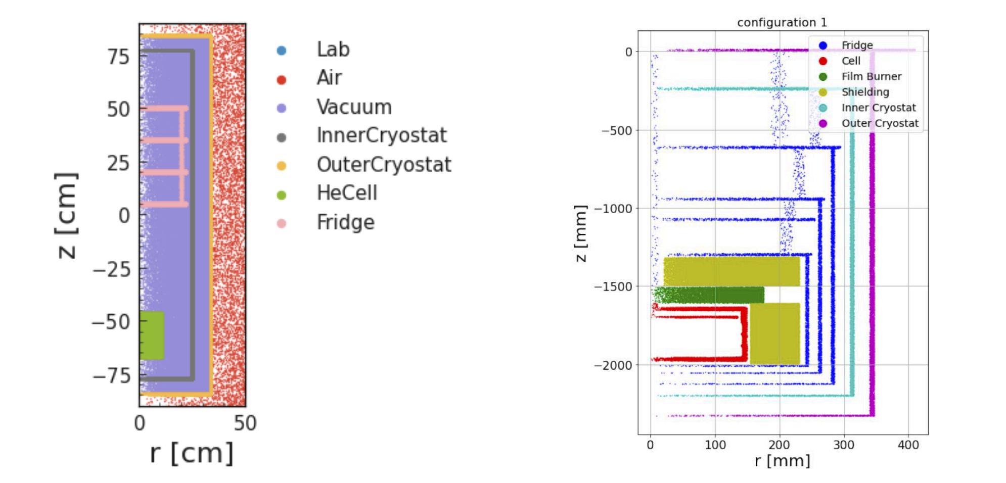
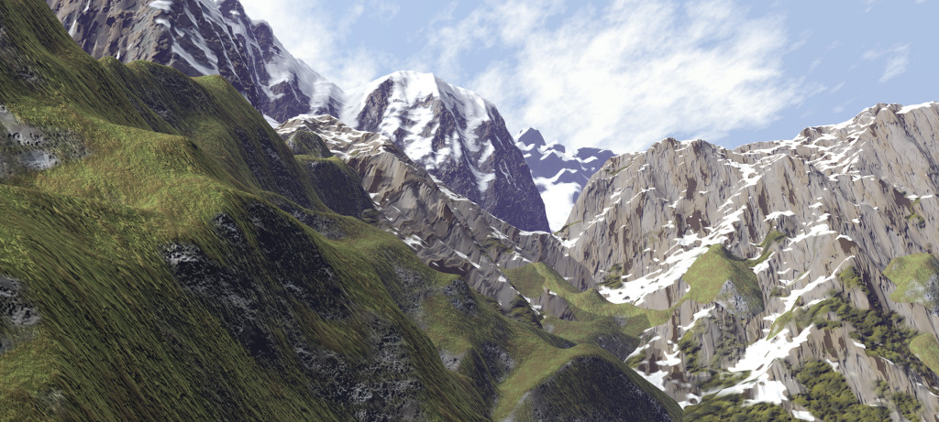
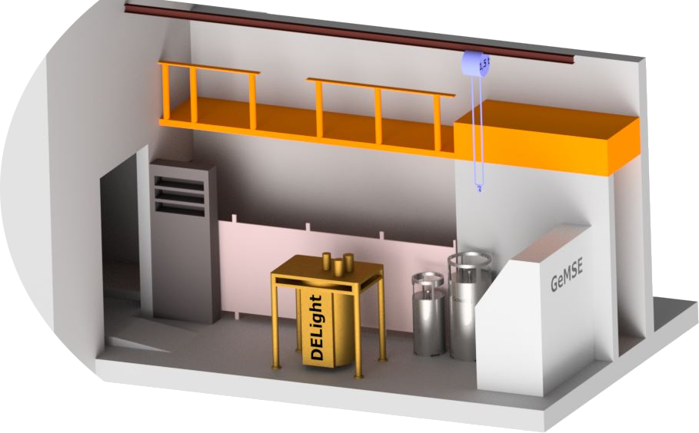
III. Dive into the cell_4
– Low background environment
Vue-des-Alpes underground laboratory
Shallow underground lab close to Neuchâtel, Switzerland
Rock overburden of 620 m.w.e. ⇒ muon flux reduced by 1/2000
Gamma and radon background measurements
Operated by University of Freiburg (hosting GeMSE gamma spectrometer)

Slide 13
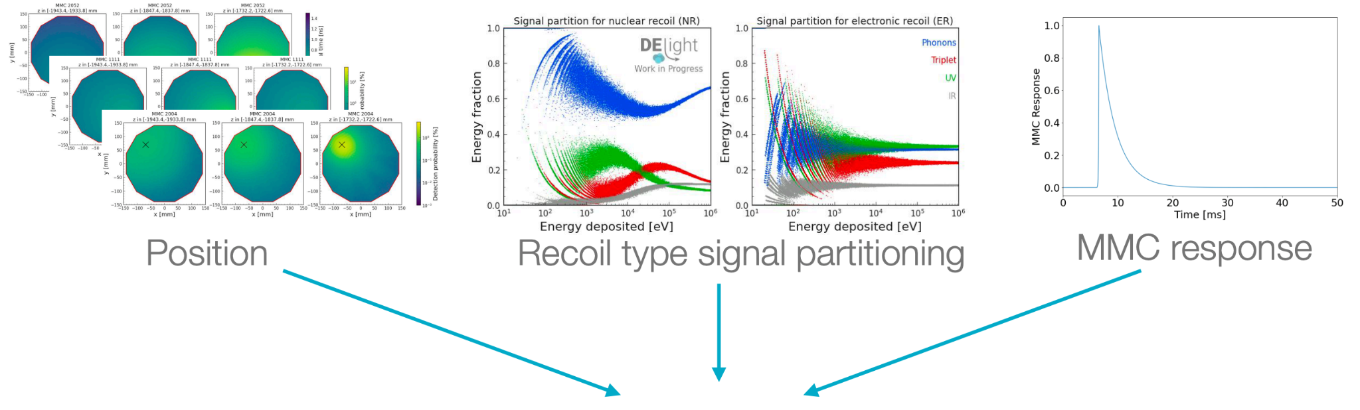
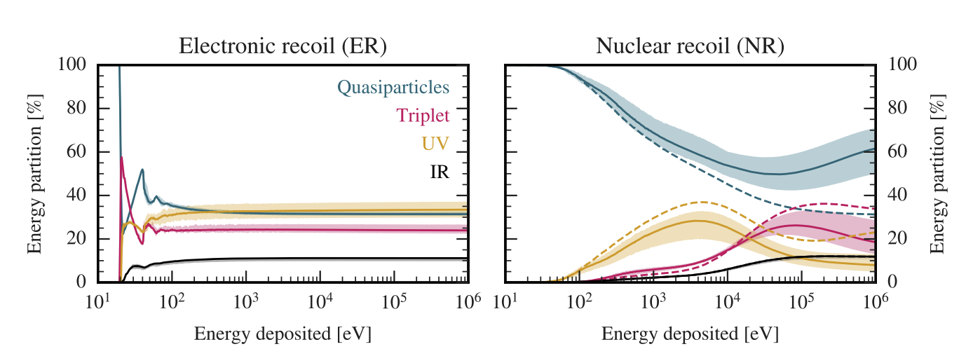
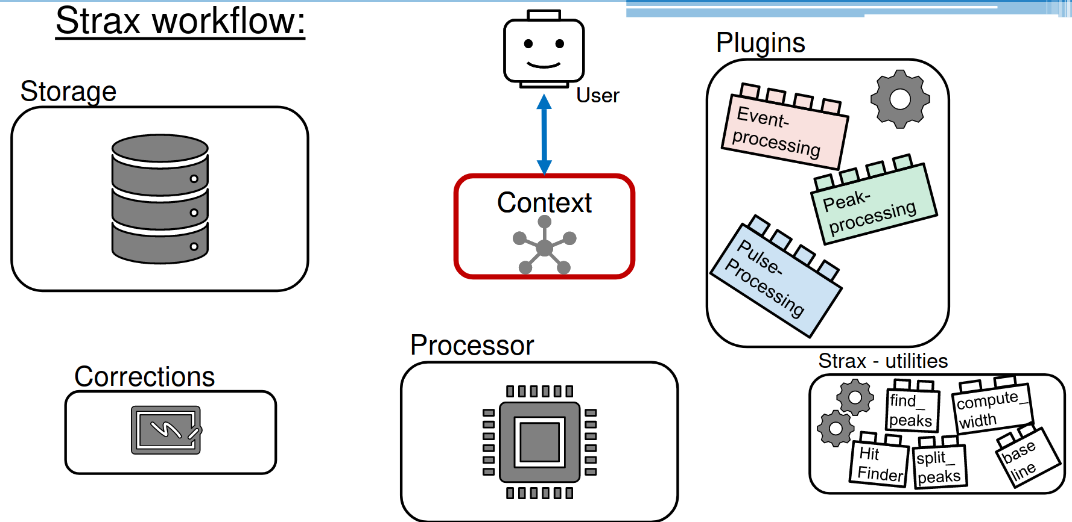
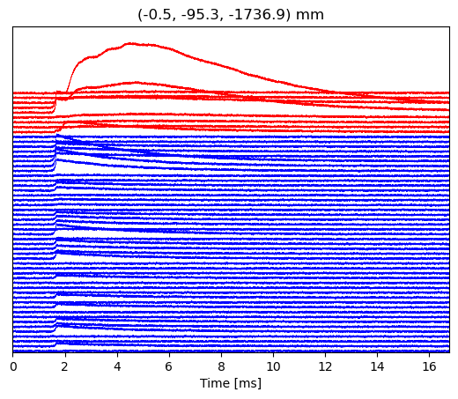
IV. Software: Simulation and Reconstruction_0
– Simu software and Reco pipeline
Helix is a data processing software for DELight and MMC R&D projects, developed based on the Xenon-based dual phase TPC analysis software strax
The TraceSimulator is configured based on the geometry of the proposed test cell, accounting for nuclear and electron recoil.
With ongoing study on the secondary effects, such as the Migdal effect and Bremsstrahlung.
Diffusion model for generating simulation data at R&D stage(ICL)

Slide 14
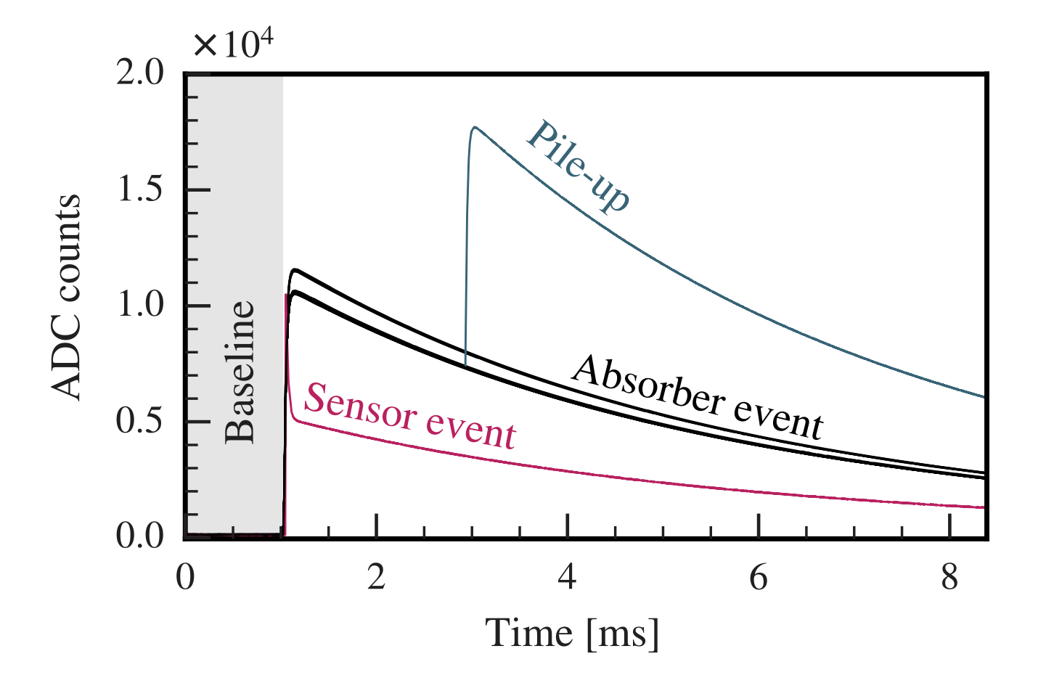
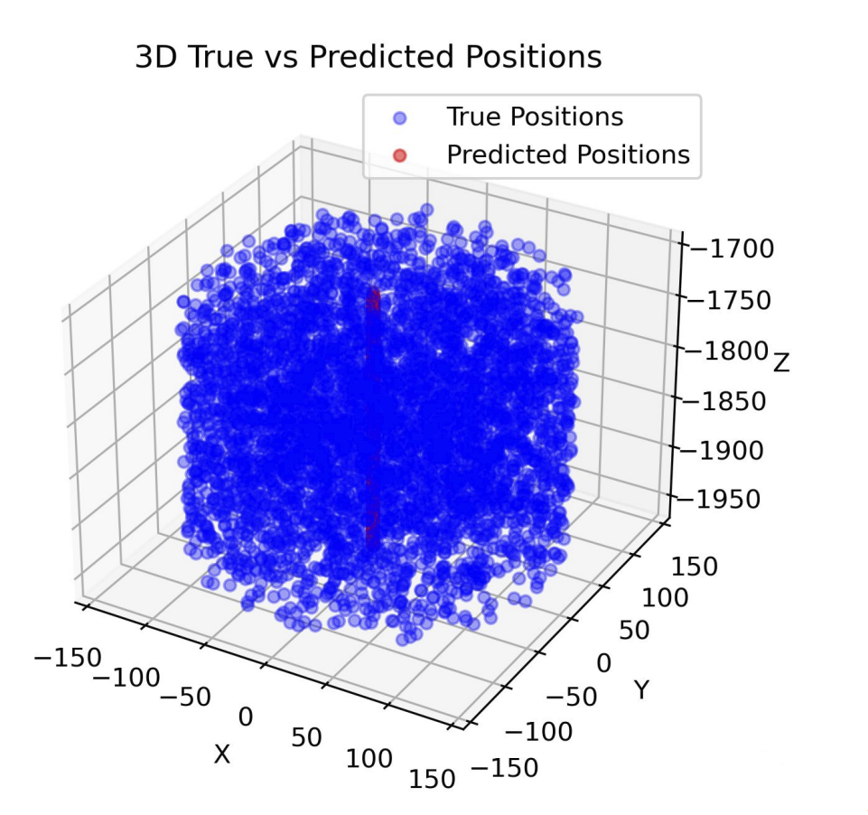
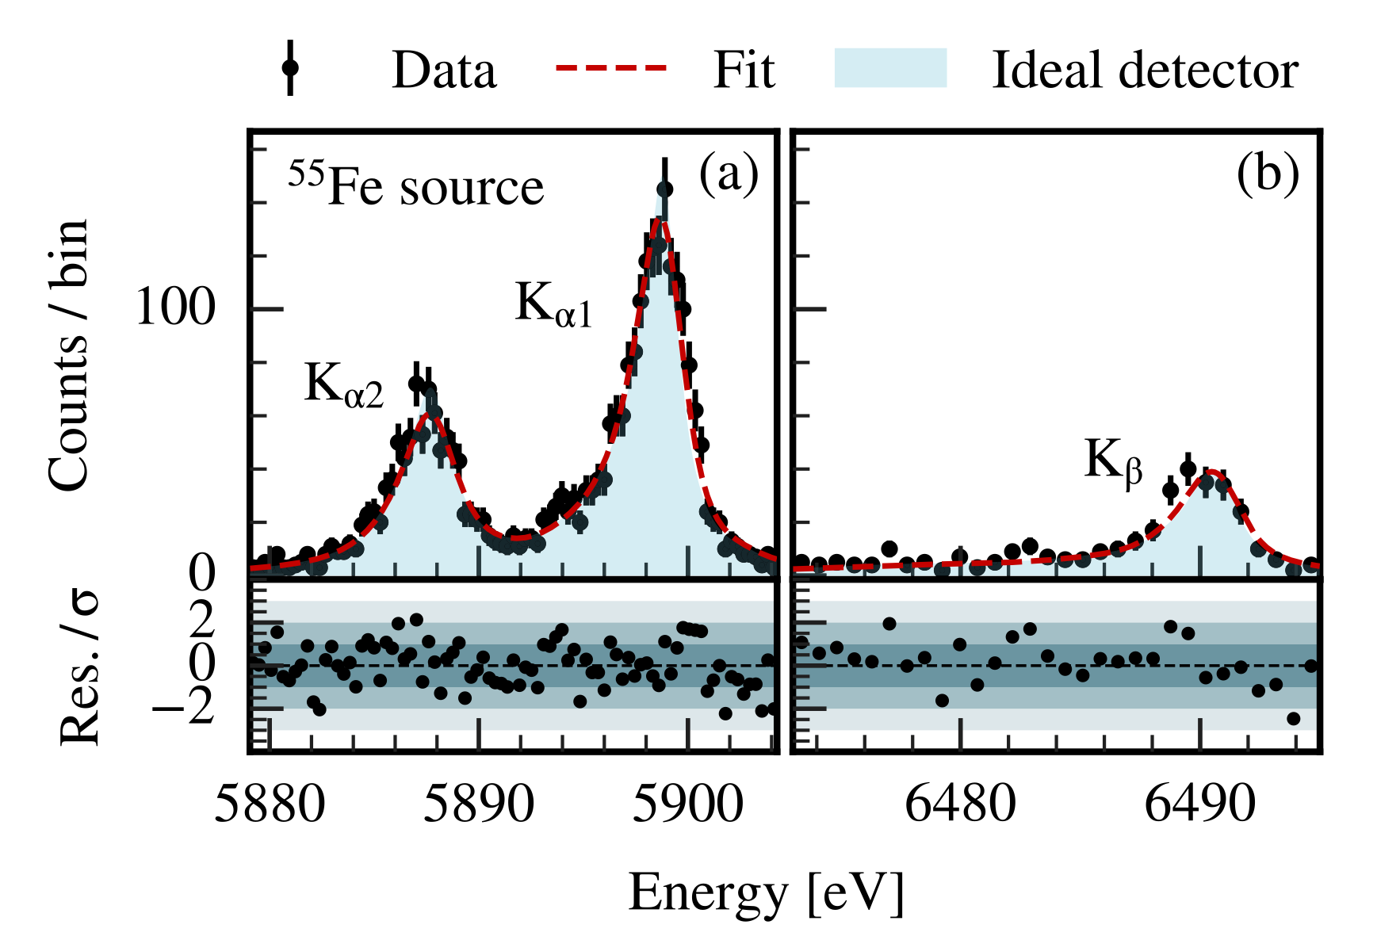
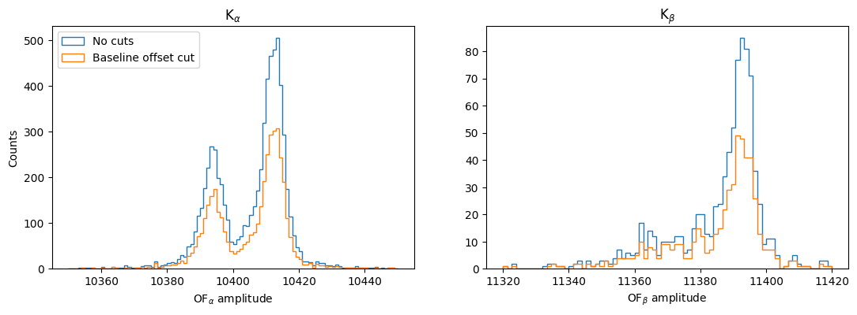
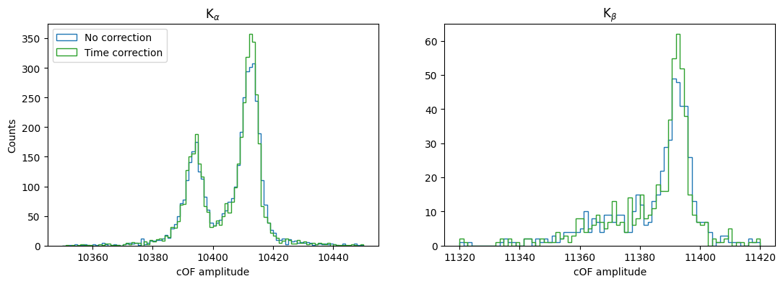
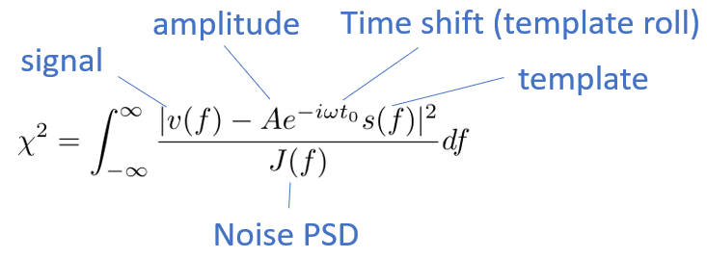
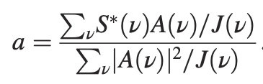
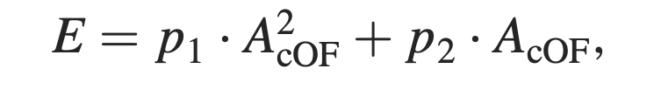
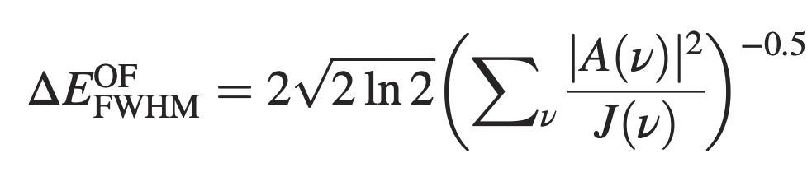
IV. Software: Simulation and Reconstruction_1
– Energy and position reconstruction
Position reconstruction(ICL):
Transformer-based position reconstruction, takes in waveform per channel and correlates it with other channels.
Currently able to reconstruct the z coordinate of the recoil event.
Approximating energy reconstruction with a non-linear response of MMC
MMCs have achieved a world-leading energy resolution of ∆EFWHM = 1.25 eV for 5.9 keV photons

Slide 15
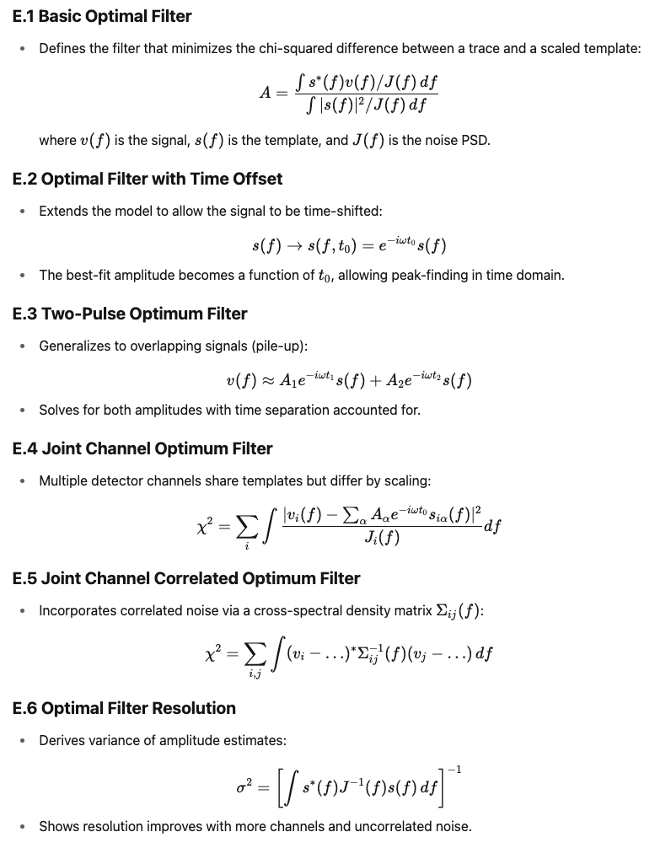
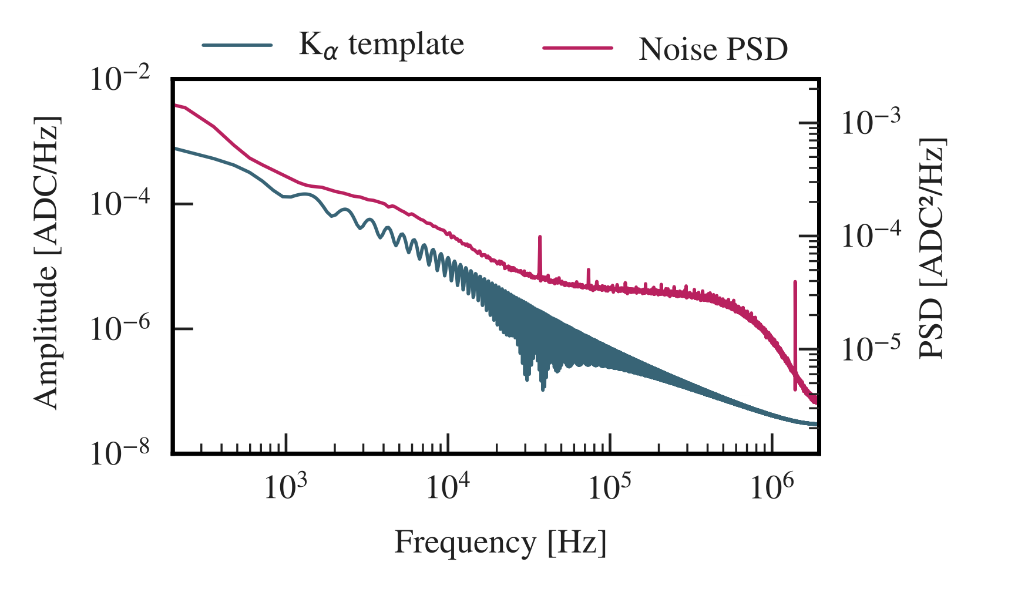
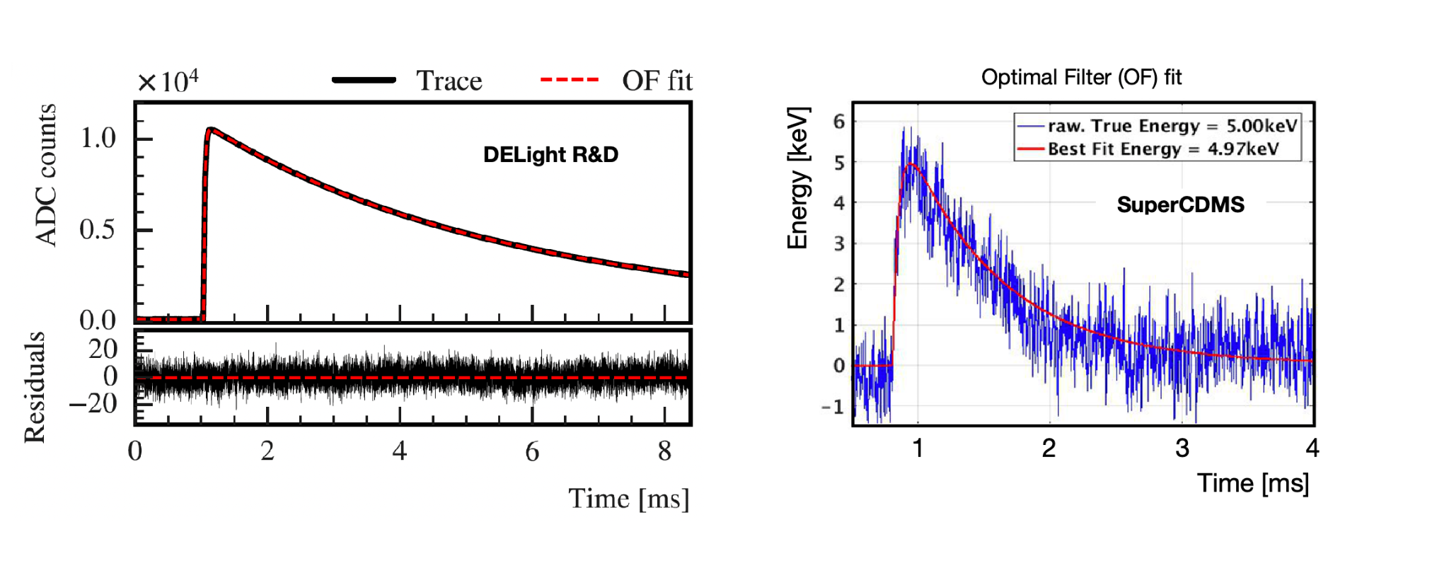
IV. Software: Simulation and Reconstruction_2
– OF trigger_0
Expect to achieve moderate threshold of about 20 eV, as planned during phase-I of DELight, a DM-nucleon
scattering cross section of < 1e-39 cm^2 at 200 MeV can be probed.
Kurinsky, Noah Alexander. "The Low-Mass Limit: Dark Matter Detectors with eV-Scale Energy Resolution." , Jan. 2018.

Slide 16
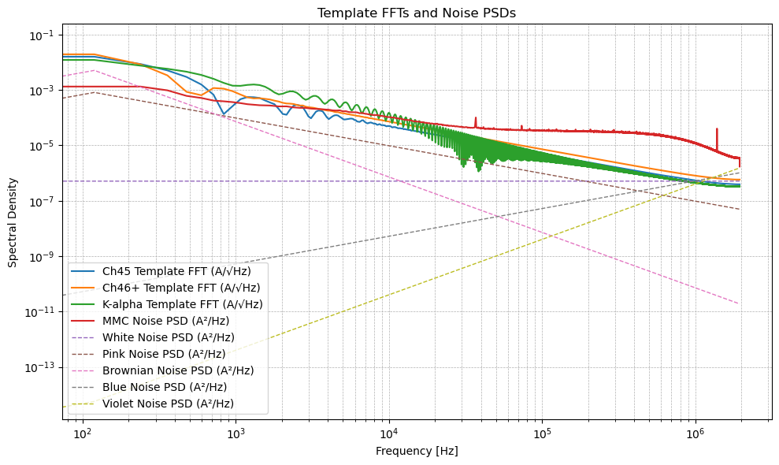

IV. Software: Simulation and Reconstruction_3
– OF trigger_1: Noise study for trigger threshold
--- Processing white noise --- OF Amplitude: Mean: -0.0019 Std: 0.1178 Min: -0.3489 Max: 0.3590 | --- Processing pink noise --- OF Amplitude: Mean: 0.0024 Std: 2.5090 Min: -8.9976 Max: 8.9004 | --- Processing brownian noise --- OF Amplitude: Mean: 0.0005 Std: 0.4940 Min: -1.7999 Max: 1.6429 | --- Processing blue noise --- OF Amplitude: Mean: -0.0000 Std: 0.0016 Min: -0.0043 Max: 0.0039 | --- Processing violet noise --- OF Amplitude: Mean: 0.0000 Std: 0.0000 Min: -0.0001 Max: 0.0001 | --- Processing from_MMC noise --- OF Amplitude: Mean: -0.0012 Std: 0.7674 Min: -3.0326 Max: 2.6602

Slide 17




IV. Software: Simulation and Reconstruction_5
– OF trigger_3: Individual channel trigger
Why ER performance better than NR?
Instead of a rolling approach, we have implemented a sliding optimum filter (OF) trigger, which better suits our signal characteristics by focusing on the leading edge of the pulse and avoiding interference from the long quasiparticle tail.
A. Zaytsev. Light Dark Matter Searches and Modeling of Charge Propagation Effects in SuperCDMS Cryogenic Silicon R&D Detectors with eV-Scale Sensitivity. Karlsruhe Institute of Technology, 2023.

Slide 18




IV. Software: Simulation and Reconstruction_6
– OF trigger_4: Joint+sum channel mixed trigger
Joint channel sliding OF trigger
The vacuum channel is optimized for phonon detection, where signals are typically shared across multiple channels with varying arrival times due to propagation delays. This pattern aids in reconstructing event position and energy.
The submerged channel is designed for UV scintillation light collection. These signals arise from prompt singlet decays and exhibit consistent timing across channels for a given recoil event, enabling precise timing and event identification.
Our first-stage results demonstrating improved sensitivity compared to individual channel triggering, pushing the limit to 20 eV
Sum & Individual sliding OF trigger
Chang, C.L., et al. "First Limits on Light Dark Matter Interactions in a Low Threshold Two Channel Athermal Phonon Detector from the TESSERACT Collaboration." TESSERACT Collaboration, Mar 2025.

Slide 19





VI. Exciting and robust work is underway
—stay tuned!

